Slide 1



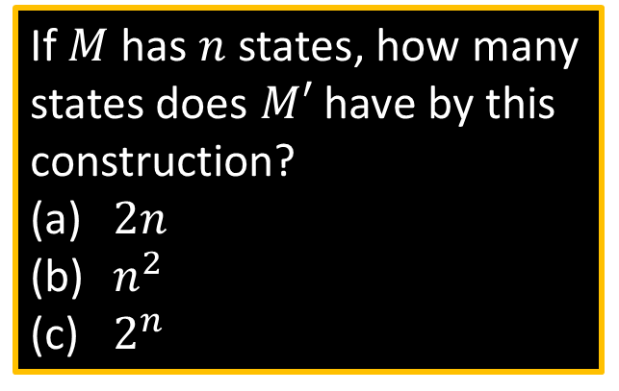





Converting NFAs to DFAs
If $M$ has $n$ states, how many states does $M′$ have by this construction?
$2n$
$n^{2}$
$2^{n}$
Theorem: If an NFA recognizes $A$ then $A$ is regular
Proof: Let NFA $M=(Q, Σ,δ, { q}_{0}, F)$ recognize $A$ Construct DFA $M′=(Q′, Σ,δ′, { q}_{0}^{′}, F′)$ recognizing $A$
(Ignore the ε-transitions, can easily modify to handle them)
IDEA: DFA $M′$ keeps track of the subset of possible states in NFA $M$.
$$M′$$
Construction of $M′$:
$Q′=𝓟\left(Q\right)$
$δ^{′}\left(R,a\right)=\left\{q\right| q∈δ(r,a)$ for some $r∈R\}$
$q_{0}^{′}=\{q_{0}\}$
$F′=\left\{R∈Q^{′}\right| R$ intersects $F\}$
$$M$$
$${ q}_{3}$$
${ \{q}_{3}$,$q_{7}\}$
$R∈Q′$
$${ q}_{7}$$
NFA
DFA
Notes:
Ans: (c)
Because we take all the combinations of the states.

Slide 2



Converting NFA to DFA: Lambda Closure
The λ-closure of a state S, denoted λ(S), is the set consisting of S together with all states that can be reached from S by traversing $\text{ε}$-edges.
Example. Given the following NFA, some sample λ-closures for the NFA are as follows:
λ(0)={0, 1, 2}
λ(1)={1, 2}
λ(2)={2}
We have: λ(C , D)=λ (C) U λ (D)
Example: λ(1,2)= λ(1) U λ(2) ={1,2}
1
a
$$\text{ε}$$
b
a
S
0
$$\text{ε}$$
b
2
Notes:
Each state itself is always in a set of lambda.
2nd Step to convert NFA to DFA is to find the lambda code of all states.

Slide 3

Transforming an NFA to a DFA
Construct a DFA table T_{D} from an NFA table T_{N} as follows:
The start state of the DFA is λ(S) (S is the start state in NFA).
If {s₁,…,s_{n}} is a DFA state and a∈ $Σ$, then
T_{D}({s₁, …, s_{n}},a) = λ(T_{N}(s₁,a)∪ … ∪ T_{N}(s_{n},a))
= λ(T_{N}(s₁, a)) ∪ … ∪ λ(T_{N}(s_{n}, a))
A DFA state is final, if one of its elements is a final state in NFA.
Notes:
Td: Table of DFA.
Tn: Table of NFA.

Slide 4


Example. Given the following NFA find the DFA
b
a
$$\text{ε}$$
b
1
2
b
S
0
$$\text{ε}$$
3
a

Slide 5




Return to Closure Properties
Recall Theorem: If $A_{1}, A_{2}$are regular languages, so is $A_{1}∪A_{2}$ (The class of regular languages is closed under union)
New Proof (sketch): Given DFAs $M_{1}$ and $M_{2}$ recognizing $A_{1}$ and$A_{2}$ Construct NFA $M$ recognizing $A_{1}∪A_{2}$
$$M$$
$$M_{1}$$
Nondeterminism parallelism, guessing
ε
ε
$$M_{2}$$

Slide 6


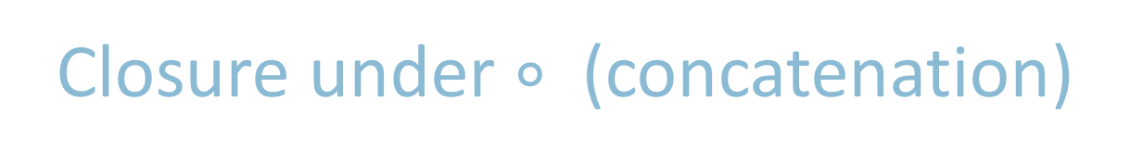






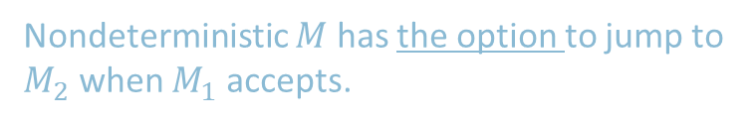
Closure under $∘$ (concatenation)
Theorem: If $A_{1}, A_{2}$are regular languages, so is $A_{1}A_{2}$
Proof sketch: Given DFAs $M_{1}$ and $M_{2}$ recognizing $A_{1}$ and$A_{2}$ Construct NFA $M$ recognizing $A_{1}A_{2}$
$$M$$
$$M_{1}$$
$$M_{2}$$
ε
$M$ should accept input $w$ if $w=xy$ where $M_{1}$ accepts $x$ and $M_{2}$ accepts $y$.
ε
$$w=$$
$$x$$
$$y$$
Nondeterministic $M$ has the option to jump to $M_{2}$ when $M_{1}$ accepts.
Notes:
Remember, in DFA, we were not able to figure out where to split the string.

Slide 7











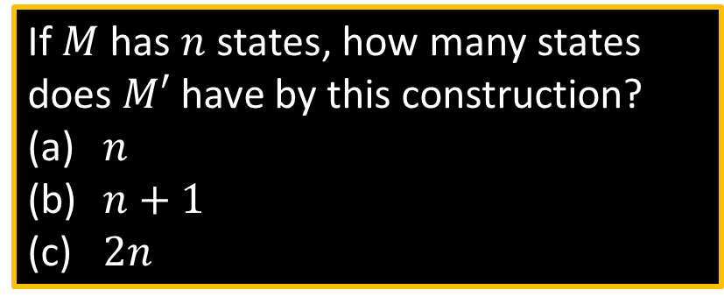
Closure under $∗$ (star)
Theorem: If $A$ is a regular language, so is $A^{∗}$
Proof sketch: Given DFA $M$ recognizing $A$ Construct NFA $M′$ recognizing $A^{∗}$
If $M$ has $n$ states, how many states does $M′$ have by this construction?
$n$
$n+1$
$2n$
$$M′$$
$$M$$
ε
$M′$ should accept input $w$
if $w=x_{1}x_{2} … x_{k}$
where $k≥0$ and $M$ accepts each $x_{i}$
ε
ε
$$w=$$
$$x_{1}$$
$$x_{2}$$
$$x_{3}$$
$$x_{4}$$
Make sure $M′$ accepts ε
Notes:
Ans: (b)
Because we defined a new state as a start state.

